Slide 1
第十八章 驱动桥
Chapter 18 Drive Axle

Slide 2
主要内容 Main Contents
驱动桥的组成、功用及结构类型；
主减速器：单级主减速器、双级主减速器、轮边减速器、双速主减速器、贯通式主减速器的特点。
差速器：齿轮式差速器、防滑差速器等。
半轴与桥壳：半轴的支承和结构、桥壳的分类、结构特点。
Composition, functions and structure types of the drive axle ；
Final drive ：single reduction final drive、double reduction final drive、hub reduction gear、 two-speed final gear 、thru-drive.
Differential ：gear differential、 antiskid differential and so on.
Axle shaft and axle case：Support and structure of axle shaft、Classification of axle case、 design feature.

Slide 3
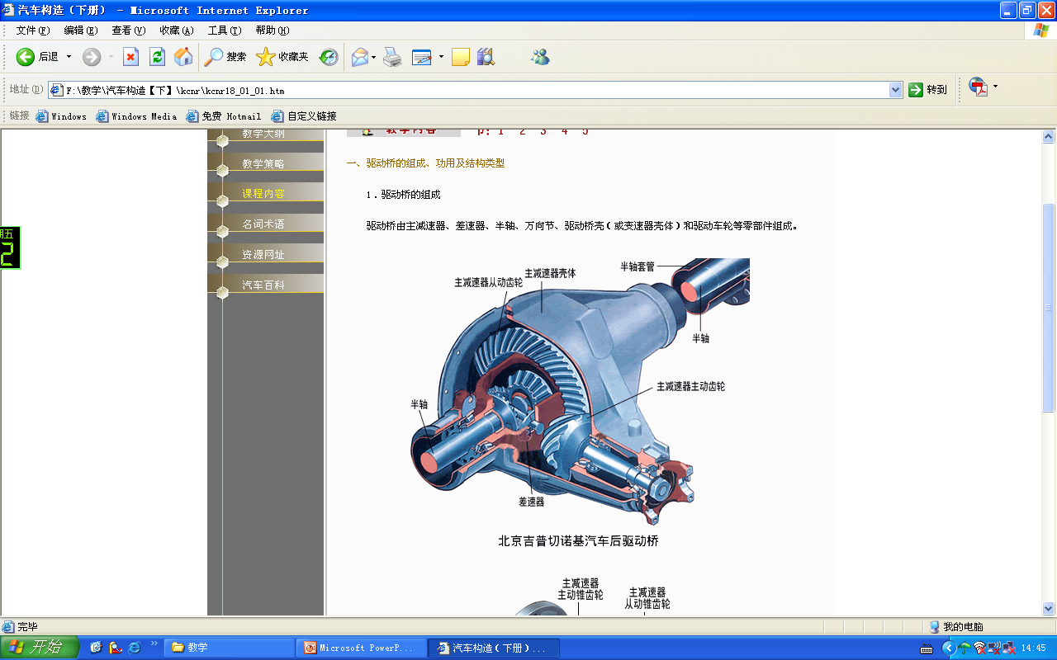
驱动桥的组成、功用及结构类型
Composition, functions and structure types of the drive axle

Slide 4
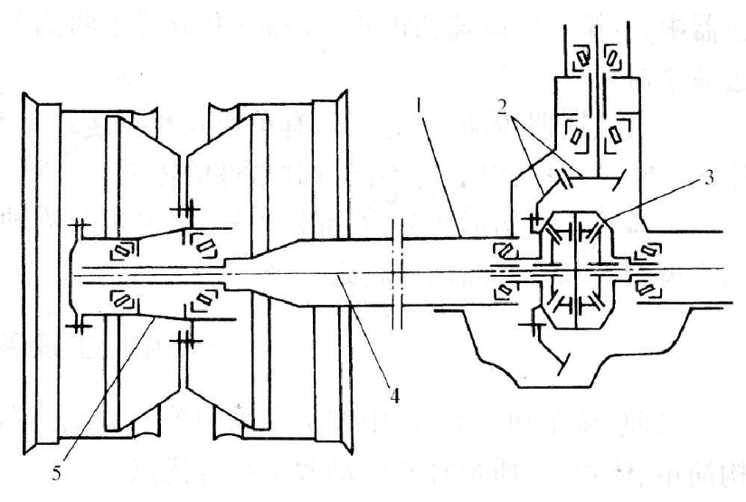
驱动桥的组成 Composition of the drive axle
主要部件：驱动桥壳（主减速器壳和半轴套管）、主减速器、差速器、半轴和轮毂等。
Components：drive axle case（final drive case and axle shaft sleeve ）、final drive、differential、axle shaft、 wheel hub and so on.
桥壳
主减速器
差速器
半轴
轮毂

Slide 5
动力传递路线 Power transmission line
万向传动装置输出轴
Universal transmission output shaft
减速增矩
Speed reduction, torque increasement
主减速器
Final drive
轴差速 axle shaft differential
差速器 Differential
半轴 axle shaft
轮毂 Wheel hub

Slide 6
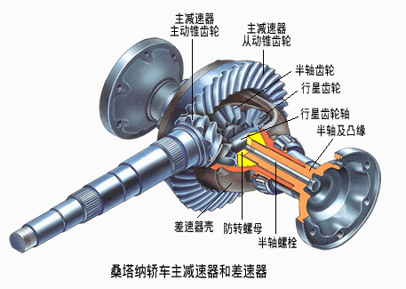
驱动桥的功用
将动力传递给驱动轮；
To pass power to driving wheels；
通过主减速器实现降低转速和增大扭矩；
To decrease speed and increase torque by final drive；
在发动机纵置时，通过主减锥齿轮改变转矩传递的方向；
With a longitudinal engine, to change the direction of torque transmission by main bevel gear；
通过差速器实现车轮的差速，保证内外侧车轮以不同转速旋转；
To ensure inside and outside wheels rotate at different speeds with the differential；
通过桥壳和车轮实现承载和传力。
To realize support and transmission through axle case and wheels.

Slide 7
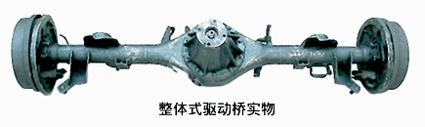
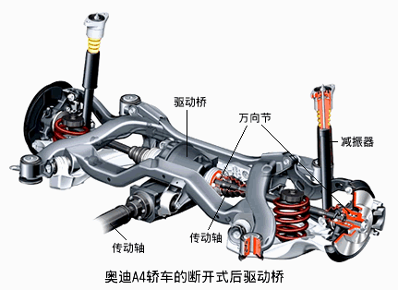
驱动桥的类型 Types of drive axle
非断开式驱动桥 The integral axle
断开式驱动桥 The divided axle

Slide 8
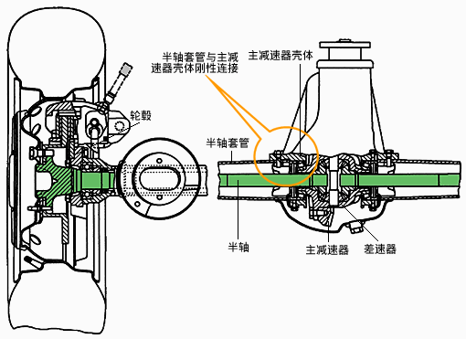
非断开式（整体式）驱动桥
The integral axle(the overall axle)
特点：半轴套管与主减速器壳体刚性连接组成一整体，整个驱动桥通过弹性悬架与车架连接，两侧的半轴和驱动轮不可能在横向平面内作相对运动。
Features：Axle shaft sleeve and final drive housing are connected rigidly as a whole. The drive axle is connected to the frame through elastic suspension. The axle shaft and driving wheels on both sides can’t move relatively in transverse plane.
车轮采用非独立悬架式结构。
Wheels use a non-independent suspension structure.

Slide 9
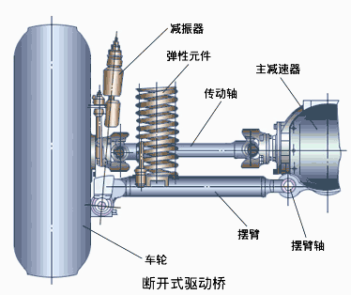

断开式驱动桥 The divided axle
特点
驱动桥壳分成两段，主减速器壳固定在车架上，半轴与传动轴通过万向节铰接，传动轴又通过万向节与驱动轮铰接；
Drive axle housing is divided into two sections，final drive housing is fixed in the frame，axle shaft and drive shaft are articulated by a universal joint，and drive shaft and driving wheel are articulated by a joint；
两侧车轮通过独立悬架与车架连接，可彼此独立地相对车架跳动。
Wheels on both sides are connected to the frame with independent suspension, and they can bounce independently.
车轮采用独立悬架式结构。
Wheels use an independent suspension structure.

Slide 10
第一节 主减速器
Segment 1 Final Drive
降低转速，增大转矩；To reduce speed and increase torque；
改变转矩旋转方向。To change the rotation of torque.

Slide 11
主减速器的分类 Classification of the final drive
按主减速器档位
By final drive shifts
单速式
Single speed type
双速式
Double speed type
按传动齿轮副的数目
By number of driving gear pair
单级主减速器
single reduction final drive
双级主减速器
Double reduction final drive
带轮边减速器的双级主减速器 wheel reducer
传动比固定
Constant ratio
有两个档位
Two shifts
按齿轮副结构形式
圆柱齿轮式
Spur gear type
圆锥齿轮式
Bevel gear type
准双曲面齿轮式
Hypoid gear type
主从动齿轮轴线平行
Axis of driving and driven gears are parallel
主从动锥齿轮轴线垂直且相交
Axis of driving and driven gears are vertical and intersectant
主从动锥齿轮轴线垂直但不相交，有轴线偏移
Axis of driving and driven gears are vertical but not intersectant，and have offset

Slide 12
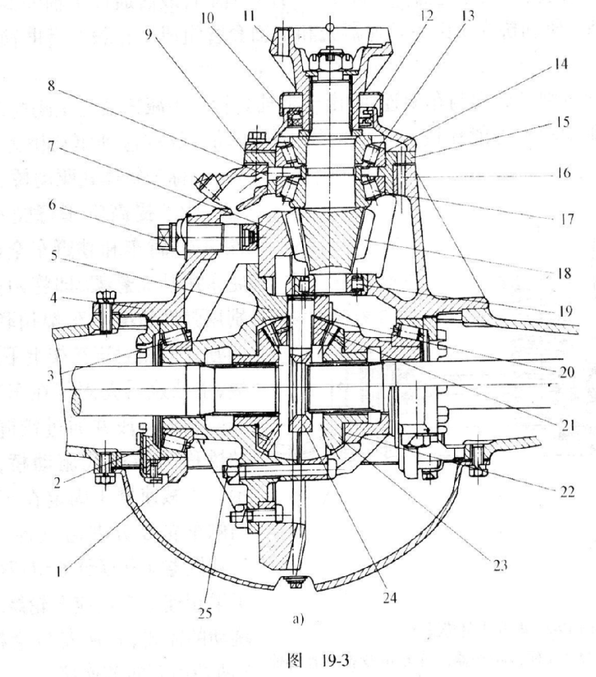
单级主减速器Single reduction final drive
主要部件：主动锥齿轮、从动锥齿轮、圆锥滚子轴承、调整垫片以及调整螺母等。
Main components：driving bevel gear、driven bevel gear从动锥齿轮、 conical roller bearing 、 adjusting shim、 adjusting nut.
特点：只有一对齿轮副传动，零件少，结构紧凑，重量轻，传动效率高。
Features：only a pair of gears，a few parts，compact structure，light weight，high transmission efficiency.
主传动比：主减速器的传动比称为主传动比，用i₀表示。
Axle ratio ：the final drive ratio is called axle ratio，expressed with i_{0.}
i₀=z₂/z₁
Z₂——从动齿轮齿数 teeth of driven gear
Z₁——主动齿轮齿数 teeth of driving gear

Slide 13
单级主减速器 Single reduction final drive
主从动锥齿轮间必须有正确的啮合位置。Correct meshing position between driving and driven bevel gear
主从动锥齿轮在啮合传递动力的过程中要尽量减小冲击噪声，且沿其长度方向磨损均匀。Try to reduce noise during the meshing of driving and driven gears，and enable even wearing along the length
必要的啮合调整装置。Necessary meshing adjusting device
结构上使主从动锥齿轮有足够的支承刚度。To enable driving and driven gears to have enough bearing stiffness in structure
以免传动过程中出现较大变形而影响正常啮合。To avoid large deformation during transmission process, which affects normal meshing

Slide 14
主从动锥齿轮的支承
Bearing of driving and driven bevel gear
目的：增加支承刚度，便于拆卸、调整。Aims：increased bearing stiffness，ease dismounting and adjustment
主动锥齿轮通常与输入轴制成一体，输入轴通过跨置式或悬臂式支承方式支承在主减速器壳体上。Driving bevel gear is usually made with the input shaft which is supported in the final drive housing in transversal or cantilever way.
从动锥齿轮用螺栓固定在差速器壳体上，差速器壳通过跨置式支承方式支承在主减速器壳体上。Driven gear is bolted on the differential housing which is supported in the final drive housing in transversal way.

Slide 15
轴承的预紧Preloading of bearings
轴承预紧度
调整垫片
目的：减小锥齿轮传动过程中的轴向力引起的轴向位移，保证齿轮副的正常啮合。
Aim：to reduce axial displacement caused by axial force ，and ensure normal gear meshing.
预紧方法
调整垫片 Adjusting shims
调整螺母 Adjusting nuts
轴承预紧度
调整螺母

Slide 16
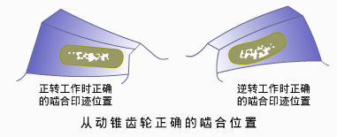
圆锥齿轮啮合的调整
Meshing adjustment of bevel gear
圆锥齿轮啮合的调整是指齿面啮合印迹和齿侧间隙的调整。
Meshing adjustment of bevel gear means the adjustment of tooth surface meshing imprinting and backlash.
圆锥齿轮正确啮合：啮合印迹位于齿高的中间靠近小齿端，并超过齿宽的60%。
Correct meshing of bevel gear：Meshing imprinting is located in the middle of height and near the small end，and is more than the 60% of the length of the tooth.

Slide 17
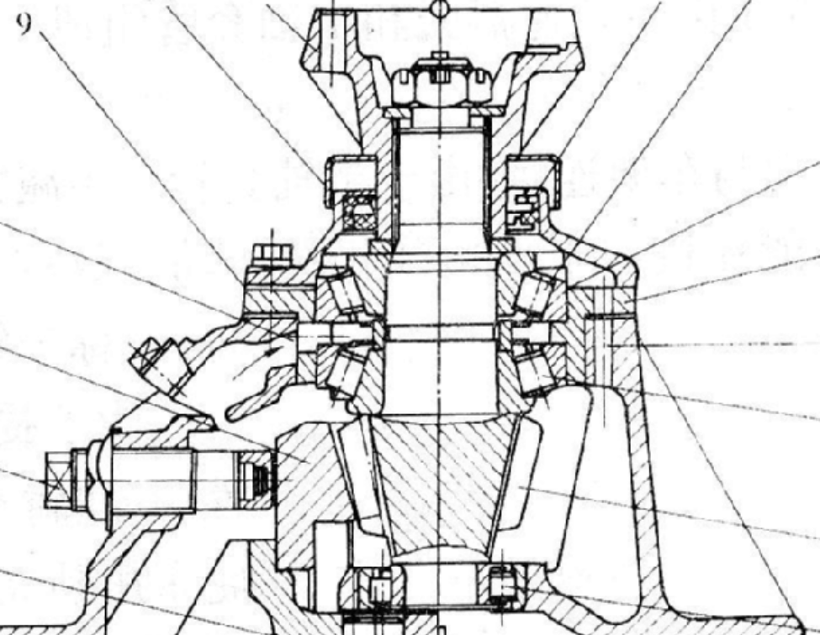
圆锥齿轮啮合的调整
Meshing adjustment of bevel gear
齿面啮合印迹的调整：改变主减速器壳与主动锥齿轮轴承座之间调整垫片的总厚度，调整主动齿轮的位置。
Tooth surface meshing imprinting adjustment：to change the thickness of adjusting shims between final drive housing and driving bevel gear bearing support and adjust the position of driving gear

Slide 18
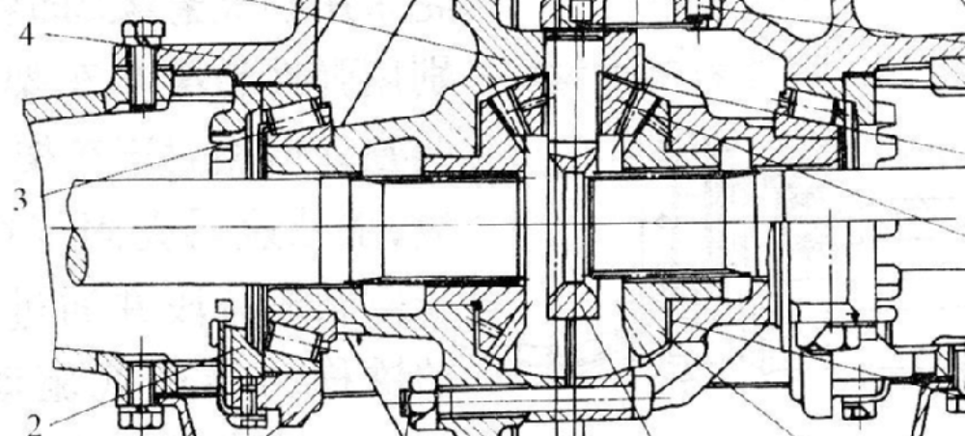
圆锥齿轮啮合的调整
Meshing adjustment of bevel gear
齿侧啮合间隙的调整：拧动轴承调整螺母，改变从动锥齿轮的位置（齿侧间隙应在0.15~0.40mm）。
Backlash adjustment：Screw bearing adjusting nut to change the position of driven gear（the range of backlash is 0.15~0.40mm）
调整螺母
adjusting nut

Slide 19
圆锥齿轮啮合的调整
Meshing adjustment of bevel gear
调整螺母
adjusting nut
为保持已调整好的差速器圆锥滚子轴承预紧度不变，一端调整螺母拧入的圈数应等于另一端螺母拧出的圈数；In order to keep the adjusted differential tapered roller bearing a good tightness，the number of ring screwed into the adjustment nut should be equal to the other end of the ring nut；
圆锥滚子轴承预紧度的调整必须在齿轮啮合调整之前进行；In order to keep the adjusted differential tapered roller bearing a good tightness，the number of ring screwed into the adjustment nut should be equal to the other end of the ring nut；
可通过同时调整调整垫片的厚度和调整螺母的位置来保证齿轮副正确的啮合位置和啮合间隙。Ensure correct meshing and backlash by adjusting the thickness of adjusting shims and the position of adjusting nut.

Slide 20
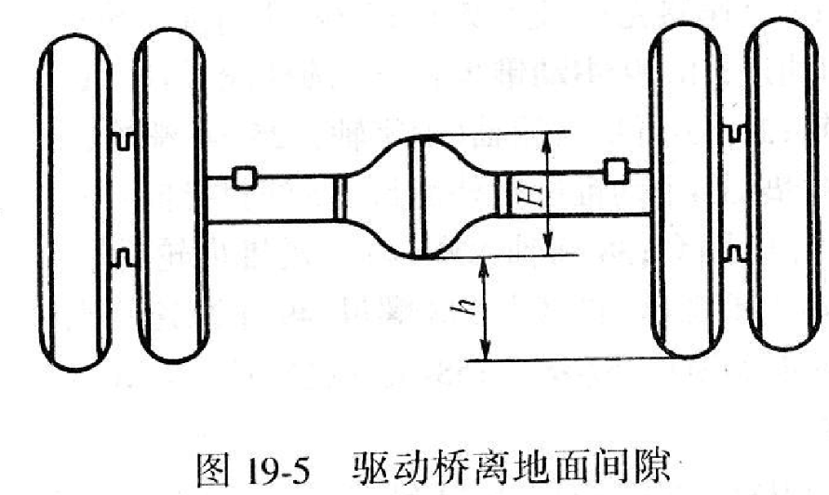
主减速器对离地间隙和地板高度的影响
Final drive effects on ground clearance and floor height
驱动桥中间部分尺寸H，对上影响车身底板高度，对下影响汽车最小离地间隙h₀。The size of drive axle intermediate part– H influences not only the body floor height but also the minimum ground clearance h₀.
驱动桥尺寸H主要取决于主减速器从动锥齿轮的大小。The size of drive axle is mainly determined by the size of driven bevel gear of final drive.
为了避免汽车的离地间隙太小和地板高度太高，应尽量减小驱动桥的高度，即在保证所要求的传动比和齿轮强度条件下尽量减小主动齿轮齿数。To avoid too small ground clearance and too high floor, the height of drive axle should be reduced, that is, minimize the number of driving gear teeth with required ratio and satisfied gear strength.

Slide 21
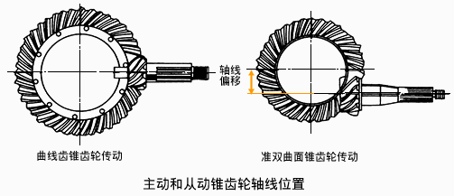
主减速器对离地间隙和地板高度的影响
Final drive effects on ground clearance and floor height
主动锥齿轮轴线向下偏移时，在保证一定离地间隙的前提下，可降低主动锥齿轮和传动轴的位置，进而降低车身和整车质心位置，提高汽车行驶稳定性。When the driving gear axis deviates downward and has a certain ground clearance，the height of driving gear and drive shaft can be reduced, so it’s the same with the body and center of mass, improving vehicle driving stability.
方法：准双曲面齿轮代替曲线齿锥齿轮。
Measure：use hypoid gear to replace bevel gear

Slide 22
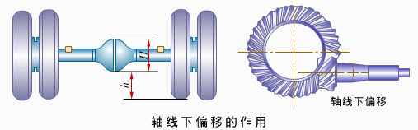
准双曲线齿轮的特点Characteristics of hypoid gear
轮齿强度高；High gear strength；
可以同时有几对齿轮进入啮合，提高承载能力，工作平稳；There can be several teeth in meshing simultaneously ，which improves the bearing capacity，and it works steadily；
可以通过轴线偏移提高离地间隙，或在离地间隙不变的情况下，降低车辆的重心高度；It can increase ground clearance by axis offset or lower vehicle's center of gravity height with the unchanged ground clearance；
齿面间有相对滑动，齿面间的压力大，容易破坏油膜，影响齿轮的寿命； There is relative sliding between teeth; high pressure on teeth surface can easily damage oil film and influence the life of the gear；
制造难度大。 It is difficult for manufacturing.

Slide 23
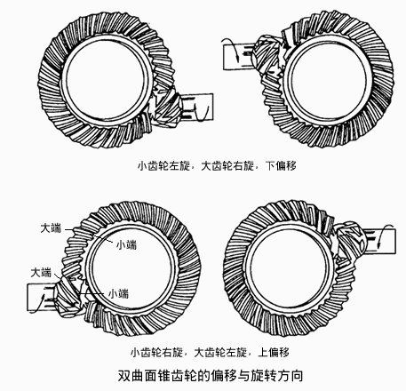
准双曲面锥齿轮的螺旋方向与轴线偏移
Direction of spiral and axis offset of hypoid gear
齿轮旋转方向的判断 ：从齿轮小端向大端看，齿面向左旋为左旋齿轮，右旋为右旋齿轮，一对准双曲面锥齿轮互为左右旋。
Judgment of direction of spiral：to look from the small end to the big one，if the tooth is left-hand it’s called left-hand gear, otherwise it’s right-hand gear
上下偏移的判断：将小齿轮置于大齿轮右侧，小齿轮轴线在大齿轮轴线下方为下偏移，反之，为上偏移。
Judgment of up or low offset：put the pinion on the right of the gear，if the axis of the pinion is below that of the gear，it is called low offset; otherwise, it is up offset.

Slide 24
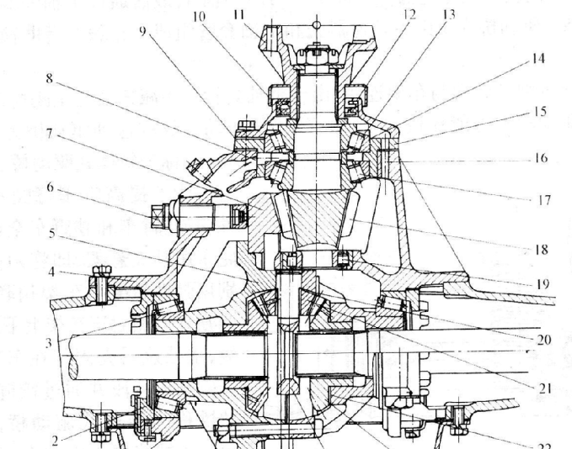
主减速器的润滑 Lubrication of final drive
主减速器采用飞溅润滑的方式，靠从动锥齿轮的转动将润滑油甩到各齿轮、轴和轴承上进行润滑。The final drive uses splash lubrication，the rotation of driven gear throws lube to gears, shafts and bearings.
主减速器壳体上设有通气孔、加油孔和放油孔。There are vent hole 、 filler well and oil drain hole in the final drive housing.
润滑油：一般采用含防刮伤添加剂的齿轮油，以免齿轮迅速擦伤和磨损，降低使用寿命。lube：gear oils with scratch-resistant additives are usually used to avoid rapid abrasion and wear of gear.

Slide 25
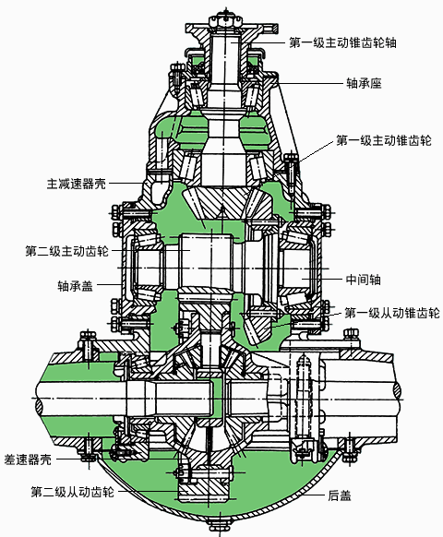
双级主减速器 double reduction final drive
当要求主减速器有较大传动比时，由一对锥齿轮传动将会导致尺寸过大，不能保证最小离地间隙的要求，这时多采用两对齿轮传动，即双级主减速器。When larger ratio is required only a pair of gears lead to bigger size and can not satisfy minimum ground clearance，then two pairs of gears are used, that is double reduction final drive
主传动比Axle ratio ：i₀=z₂/z₁× z₄/z₃
特点
由两级齿轮传动；Two-stage transmission
在实现较大传动比的前提下，提高离地间隙；Higher ground clearance with larger ratio；
可以通过更换不同的齿轮副实现不同的传动比，提高零部件的通用性。It can replace different gears to achieve different transmission ratios, increasing commonality of parts。

Slide 26
轮边减速器 wheel reductor/Hub reduction gear
在重型载货车、越野汽车或大型客车上，当要求传动系的传动比值较大，离地间隙较大时，往往在两侧驱动轮附近再增加一级减速传动，称为轮边减速器；For heavy duty truck 、off—road vehicle or large coach，when the ratio is bigger and ground clearance is higher，another grade reduction is added beside the driving wheels on both sides，which is called wheel reducter；
轮边减速也可以看作是主减速器的第二级传动。Hub reduction can be regarded as the second stage transmission of final drive.
车轮 Wheel
轮边减速器
Wheel reductor
主减速器
Final drive
主传动比Axle ratio ：i₀= i₀₁ × i₀₂
轮边减速器
Wheel reductor
车轮 Wheel
轮边减速器一般采用行星齿轮变速器。
Wheel reductor uses planetary transmission

Slide 27
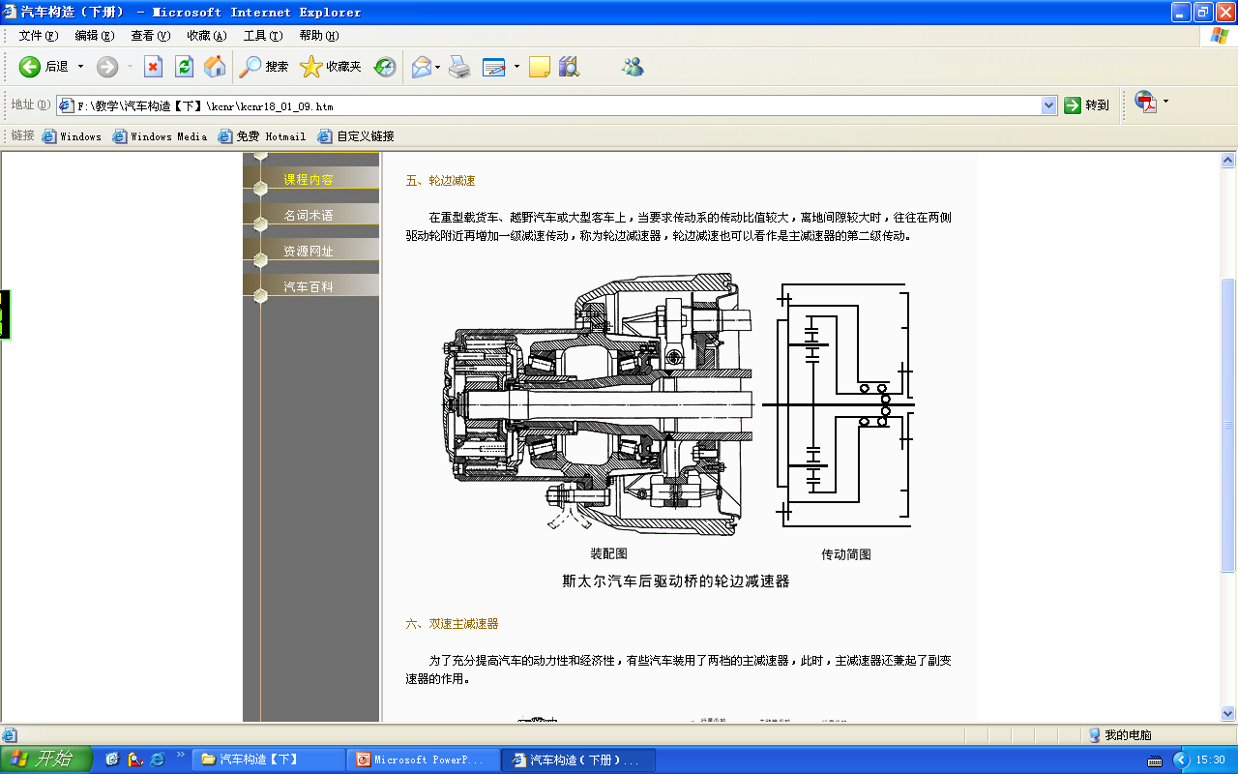
轮边减速器 wheel reductor
齿圈固定在半轴套管上，为行星齿轮机构中的固定原件；The ring gear is fixed on the axle sleeve, it is stationary part of planetary gears；
太阳轮与半轴连接，随半轴一起旋转，为主动原件。The central gear is connected with the semiaxis and rotates with it as a driving part.
行星架
Planet carrier
半轴套管
Axle sleeve
行星齿轮
Satellite gear
太阳轮
Sun gear
齿圈
Ring Gear

Slide 28
轮边减速器 wheel reductor
行星齿轮机构特性方程式Planetary gear characteristics equation ：
n₁+a*n₂－(1+a) * n₃=0
n₁：太阳轮转速 central gear speed
Z₁：太阳轮的齿数 number of central gear teeth
n₂：齿圈转速 ring gear speed
Z₂：齿圈的齿数 number of ring gear teeth
n₃：行星架转速 planet carrier speed α=Z₂/Z₁
行星齿轮机构传动比Ratio of planetary gears ：
i₀₂= 1+a
轮边减速器主传动比Ratio of wheel reductor ：
i₀= i₀₁ × i₀₂

Slide 29
双速主减速器 Two-speed final drive
为了提高汽车的动力性和经济性，有些重型车辆或越野车辆采用具有两个传动比的主减速器。In order to improve the power performance and economical efficiency, some heavy vehicle or off-road vehicle use final drive with two transmission ratios.
双速主减速器：具有两档传动比的主减速器。Two-speed final drive：the final drive with two ratios
在良好路面上采用，用小传动比的档位行驶，提高经济性，该档位常接合。Use small transmission ratio of the gear while driving on a good road to improve economy performance. This shift is often engaged.
在坏路面或载荷较大时，通过操纵装置换到大传动比档位，提高车辆的动力，该档位需要时接合。Use large transmission ratio on bad road conditions or with large load. This stall is engaged when needed.
因为操纵距离较远，一般采用气动或者电液操纵方式。Generally use pneumatic or electro-hydraulic manipulation because of long distance of manipulation.

Slide 30
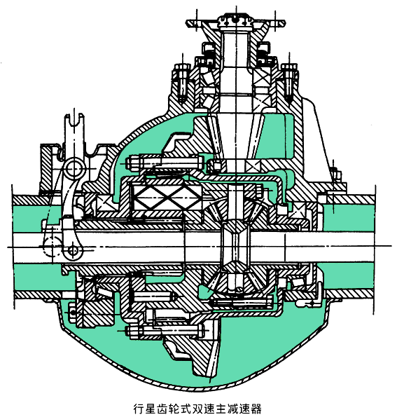
双速主减速器 Two-speed final drive
使用最为普遍的是行星齿轮式双速主减速器。
Mostly used planetary double reduction final drive

Slide 31
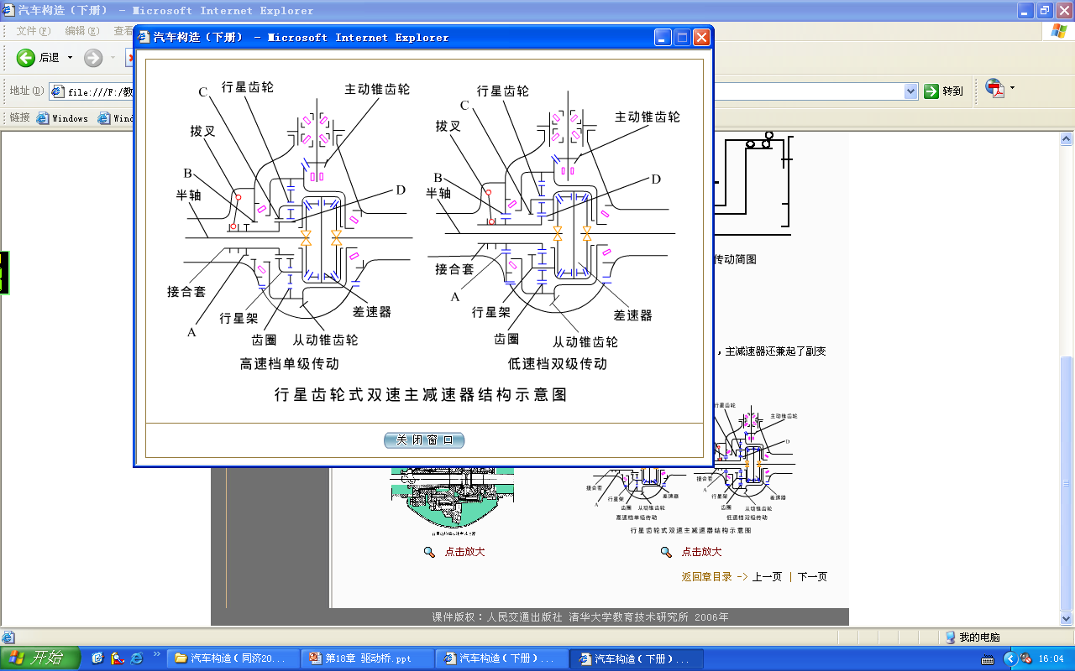
双速主减速器 Two-speed final drive
高速主传动比High speed drive ratio ：i₀=i₀₁
低速主传动比Low speed drive ratio ：i₀= i₀₁×i₀₂

Slide 32
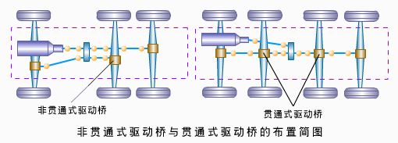
贯通式主减速器thru-drive
贯通式驱动桥：前面（或后面）两驱动桥的传动轴是串联的，传动轴从距分动器较近的驱动桥中穿过，通往另一驱动桥。Tandem axles：The front (or rear) two drive axle shafts are connected in series，the shafts go through the drive axle nearer to the transfer gear and get to another drive axle.
贯通式主减速器主要应用于多轴驱动的汽车，具有方便布置，结构简化，零部件通用性好的特点。Thru-drive is mainly used in multi-axis drive vehicle，it features easy layout，simplified structure and high universality.

Slide 33
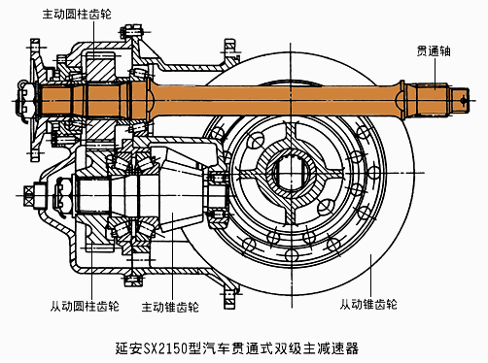
贯通式主减速器thru-drive

Slide 34
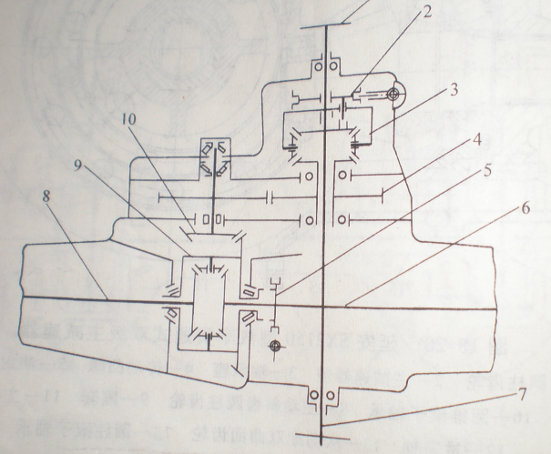
贯通式主减速器thru-drive
3轴间差速器
Inter-axle differential
4过渡箱齿轮Transition box gear
7输出轴（贯通轴）
Output shaft ( thru shaft )

Slide 35
主减速器特点总结
Summary of final drive characteristics
主从动锥齿轮要有正确的相对位置，可以通过改变齿轮轴的轴向位置进行调整，以啮合印迹和齿侧间隙来检查；The driving and driven bevel gears need be in correct relative positions. They can be adjusted by altering the axial position of the gear shaft and be checked by meshed imprinting and backlash；
要求有较高的支承刚度，以确保传递转矩的过程中主从动锥齿轮正确的相对位置不发生改变；It asks for a higher bearing rigidity, to ensure that driving and driven gears’ correct relative position do not change in the process of torque transfer.
要用圆锥滚子轴承支承，以承受锥齿轮传动的轴向力；It should be supported with conical roller bearings to withstand the axial force；
圆锥滚子轴承的预紧度可调。 Preloading of conical roller bearing is adjustable

Slide 36
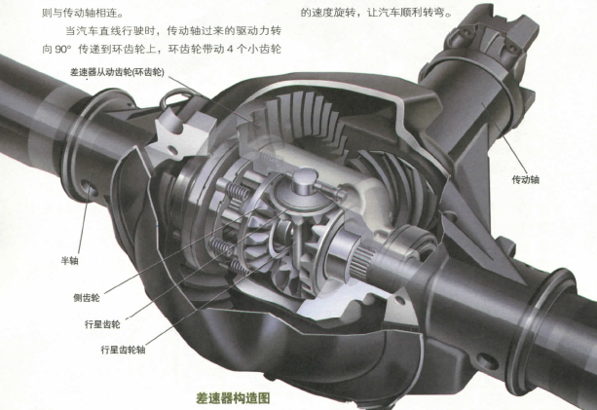
第二节 差速器
Segment 2 Differential

Slide 37
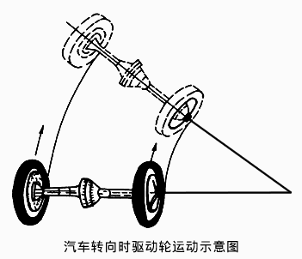
车辆转弯工况时的分析
Analysis of vehicle turning
汽车行驶过程中，车轮对路面的相对运动有两种——滚动和滑动，其中滑动又有滑转和滑移两种. In the process of driving，there are two kinds of relative motions between wheels and road—rolling and sliding , and sliding is classified as wheelspin and slippage.
设车轮中心的速度为V，车轮的纯滚动半径为r，车轮的角速度为ω。Assume that the wheel center speed is V，the rolling radius is r，the angular velocity is ω。
车轮纯滚动时pure rolling ：
V=ω×r
车轮纯滑转时pure slip ：
ω≠0，V=0
车轮纯滑移时simple slip ：
V ≠0，ω=0

Slide 38
车辆转弯工况时的分析
Analysis of vehicle turning
当汽车转弯时，在同一时间内，外侧车轮位移长，内侧车轮位移短。When the automobile turns, the outer wheel displacement is longer, and the inner wheel displacement is shorter.
如果内外车轮转速相同，则外侧车轮一边滚动一边滑移，而内侧车轮一边滚动，一边滑转。If the rotational speeds of all wheels are the same, the outer wheels scroll and slide, the inner wheels scroll and slip.
差速器的作用：当汽车转弯或者在不平路面上行驶时，使左右车轮以不同的转速滚动。Functions of differential：when the automobile makes a turn or runs on an uneven road, the left and right wheels rotate at different speeds.

Slide 39
差速器分类 Classification of differentials
轮间差速器
Wheel differential
用于同一驱动桥的两侧驱动轮之间的差速器。It is used in one drive axle and is between the two driving wheels
轴间差速器
inter-axle differential
用于两个驱动桥之间的差速器。
It is used between two drive axles
当左右或前后驱动轮与路面间的附着系数差异较大时，简单的齿轮式差速器无法保证汽车获得足够的驱动力，经常遇到这用情况的汽车应采用防（限）滑差速器。When the left and right or front and rear driving wheels have big difference in adhesion coefficient with roads，the simple gear differential cannot guarantee the automobile obtain sufficient driving force，then antiskid differential is used.
防滑差速器常见的形式有强制锁止式差速器、高摩擦自锁式差速器、牙嵌式自由轮差速器、托森差速器、粘性联轴（差速）器等。Common types of antiskid differential are as follows: locking differential、high-friction self-locking differential、jaw free wheel differential、 torsen differential 、viscous clutch and so on.

Slide 40
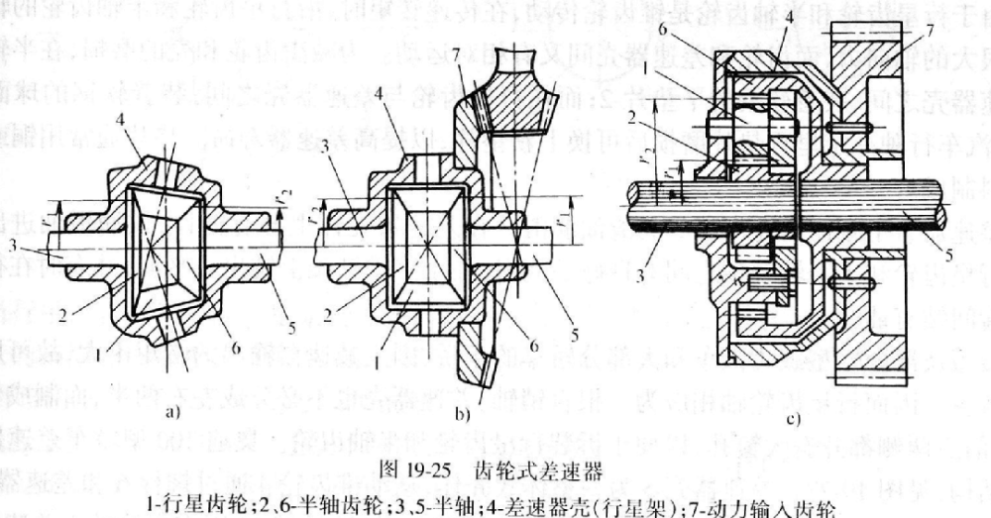
齿轮式差速器 Gear differential
按齿轮的形状
圆锥齿轮差速器
Bevel gear differential
圆柱齿轮差速器
Spur gear differential
按两侧半轴输出的转矩是否相等
对称式差速器 Symmetric differential
不对称差速器 Asymmetric differential
目前在汽车上广泛使用的是对称式锥齿轮差速器。 symmetrical bevel gear differential

Slide 41
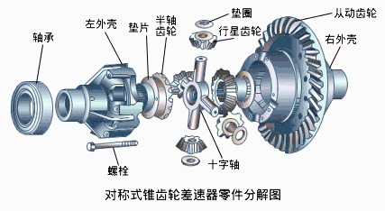
对称式锥齿轮差速器结构
Structure of symmetrical bevel gear differential
主要部件：圆锥行星齿轮、十字轴、半轴锥齿轮以及差速器壳等。Major component ：bevel planetary gear, cross axle, semi-axle bevel gear, differential case and so on
为减少磨损，在半轴齿轮和差速器壳之间装有软钢制的半轴齿轮推力垫片，在行星齿轮和差速器壳之间装有软钢制的行星齿轮球面垫片。In order to reduce abrasion，there are soft steel side gear thrust washers between side gear and differential case，and there are soft steel planetary gear spherical gaskets between planetary gear and differential case.

Slide 42
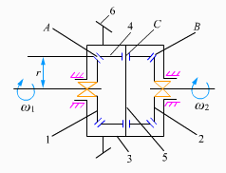
差速器的差速原理
The principle of differential
主动件：主减速器从动齿轮、差速器壳、行星齿轮轴Driving parts：driven gear of final drive、differential case、planetary-gear pin
从动件：半轴齿轮。Driven part：side gear
A点为左半轴锥齿轮与行星齿轮的啮合点。A is the meshing point of left axle shaft gear and planetary gear
B点为右半轴锥齿轮与行星齿轮的啮合点。B is the meshing point of right axle shaft gear and planetary gear

Slide 43
差速器的差速原理
The principle of differential
C点为行星齿轮的回转中心，C点的速度永远与行星齿轮轴速度相同。C is the center of rotation of planetary gear，speed of C point is always the same with planetary-gear shaft speed.
设行星齿轮轴的速度为ω₀，A、B、C三点到差速器旋转中心的距离相等，均为r。Assume planetary gear shaft speed is ω₀. The distances from point A、B、C to the rotation center of differential case are equal，and it is assumed to be r.

Slide 44
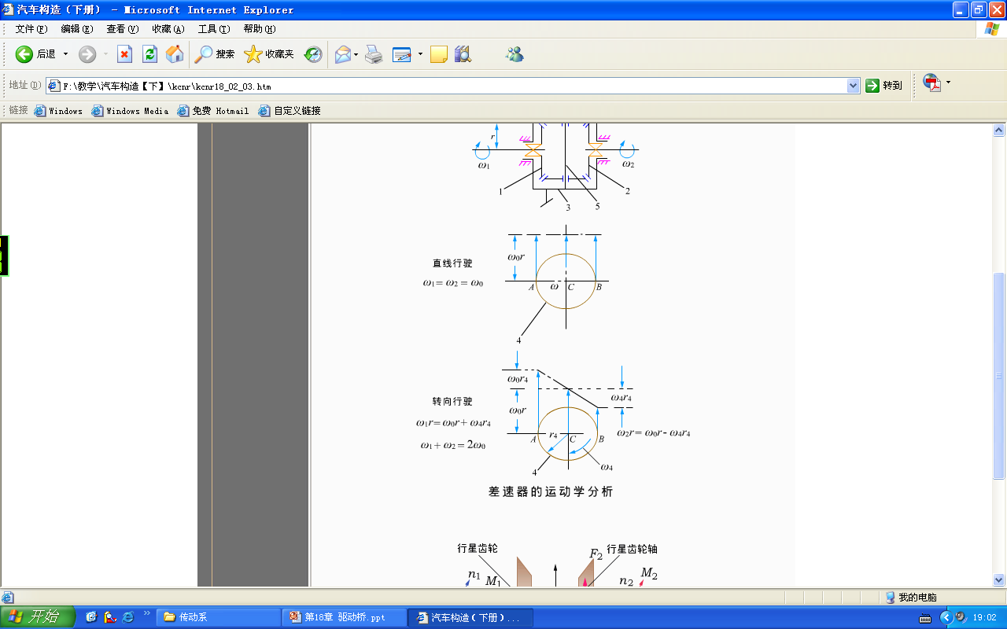
差速器的差速原理
The principle of differential
当左右车轮速度相等时，行星齿轮不自转，A、B、C线速度相同，则有When the left and right wheel speeds are equal, the planetary gear does not rotate, A, B, C linear velocities are the same，then
ω₁=ω₂=ω₀

Slide 45
差速器的差速原理
The principle of differential
当左右车轮速度不相等时，假设左车轮速度较大，则行星齿轮自转，设其自转速度为ω₄，则A点的线速度为When the left and right wheel speeds are not equal, if left wheel velocity is larger, the planetary gear rotates. Assuming its autorotation speed is ω₄，linear velocity of A point is
ω₁×r=ω₀×r＋ω₄×r₄
B点的线速度为linear velocity of B point is
ω₂×r=ω₀×r－ω₄×r₄
ω₁×r＋ω₂×r=2ω₀×r
ω₁＋ω₂=2ω₀

Slide 46
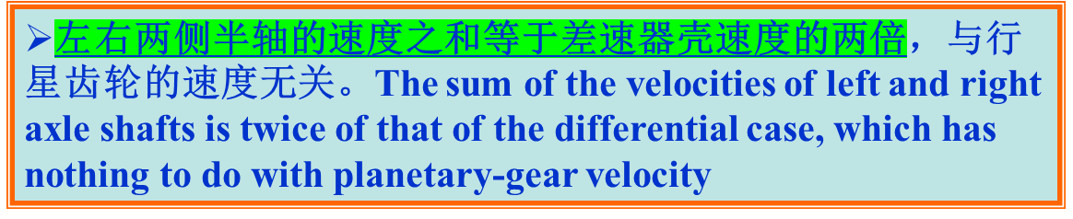
差速器的差速原理
The principle of differential
n₁＋n₂=2n₀
当任何一侧半轴齿轮的转速为零时，另一侧半轴齿轮的转速为差速器壳的两倍；When the velocity of either side gear is zero，the velocity of the other gear is twice of that of differential case；
当差速器壳的速度为零时，若一侧半轴受到其它外来力矩而转动，则另一侧半轴以相同的转速反转。When the velocity of differential case is zero，if one axle shaft rotates by external force，then the other axle shaft reverses with the same speed.

Slide 47
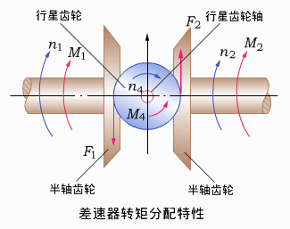
差速器的转矩分配
Torque distribution of differential
在结构上行星齿轮相当于一个等臂杠杆，两个半轴齿轮的半径相等。The planetary gear is equitant to an equal armed lever in structure, and the radium of two side gears are equal.
设主减速器传来的扭矩为M₀，左右半轴的转矩分别为M₁、M₂。Assume that the torque from final drive is M₀，the torque of left and right axle shaft is respectively M₁、M₂。
当左右半轴转速相等时，行星齿轮只有公转没有自转。When the velocities of left and right axle shaft are the same，there is only revolution but no rotation of planetary gear.
M₁=M₂=M₀/2

Slide 48
差速器的转矩分配
Torque distribution of differential
当两半轴齿轮以不同转速朝相同方向转动时，设左半轴转速n₁大于右半轴转速n₂。When two side gears rotate at different speeds in the same direction，assume that the speed of left axle shaft (n₁)is larger the that of right axle shaft (n₂)
行星齿轮将以n₄绕行星齿轮轴按右图方向自传。Planetary gear rotates around planetary-gear pin with speed n₄ , as is shown in the right picture.
行星齿轮孔与行星齿轮轴颈以及齿轮背面与差速器壳之间将产生摩擦，进而产生摩擦力矩Mr，方向与n₄相反。There is friction between planetary gear hole and planetary-gear pin and between gear back and differential case, and there is torque Mr，the direction of which is opposite to n₄
当左右两轮存在转速差时，摩擦力矩使得转的快的半轴转矩减小，转的慢的半轴转矩增大。 When difference of left and right wheel speed exits，frictional torque enables the torque of fast-rotation axle shaft decrease，and the torque of slow-rotation one increase
M₁=(M₀－M_{r})/2
M2=(M₀＋M_{r})/2

Slide 49
差速器的转矩分配
Torque distribution of differential
锁紧系数K：表示内摩擦力矩的大小和转矩的分配特性。Locking coefficient K：it describes the amount of internal frictional torque and torque distribution characteristics
K=(M₂－M₁)/M₀=M_{r}/M₀
转矩比K_{b}：表示转得慢的半轴和转得快的半轴的转矩比。Torque ratio K_{b}：it describes the ratio of the torque of slow-rotation axle shaft and that of fast-rotation one
K_{b}=M₂/M₁=(1＋K)/(1－K)

Slide 50
对称式锥齿轮差速器的缺点
Disadvantages of symmetric bevel gear differential
K=0.05~0.15
K_{b}=1.1~1.4
无论左右驱动轮是否相等，其转矩基本上总是平均分配。Whether the speeds of left and right driving wheels are equal, the torque is always evenly distributed
对称式锥齿轮差速器的运动学和动力学特性可以概括为“差速但不差转矩”，即可以使两侧驱动轮以不同转速转动，但不能改变传给两侧驱动轮的转矩。The characteristics of kinematics and kinetics symmetric bevel gear differential can be describes as “different speeds but the same torque”，that is it can make driving wheels on both sides rotate at different speeds but can’t change their torques.
左右驱动轮与路面的附着系数相差较大时，总驱动力不足以克服汽车行驶阻力。When difference of friction coefficient between the left and right driving wheels and the road is large, the total driving force is not enough to overcome the vehicle running resistance.

Slide 51
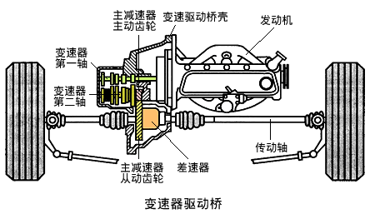
第三节 变速驱动桥
Segment 3 Transaxle

Slide 52
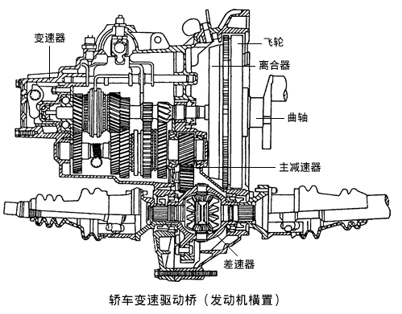
变速驱动桥 Transaxle
在发动机前置前驱动的传动系统中，发动机、变速器、主减速器和差速器成为一体式传动。In the transmission system of FF, the engine, transmission, final drive and differential form an integrated transmission
该结构可同时完成变速、差速和驱动轮等功能，称为变速驱动桥。This structure can complete simultaneously variable speed , differential peed ,driving wheel and so on, it is called transaxle
特点：结构紧凑，缩短了传动链，机械效率高，工艺复杂。Characteristics：compact structure，shorter drive chain，high mechanical efficiency，complex process

Slide 53
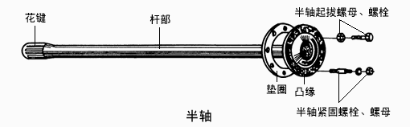
第四节 驱动车轮的传动装置与桥壳
Segment 4 The transmission device of the driving wheel and axle housing
半轴 Axle shaft
半轴是差速器与驱动轮之间传递动力的实心轴。Axle is a solid shaft of the power transmission between the differential and the driving wheels
作用：将动力直接传递给驱动轮。function：power is directly transmitted to the driving wheels
按支承方式
By support way
全浮式半轴支承 Full floating axle support
半浮式半轴支承 Semi-floating axle support

Slide 54
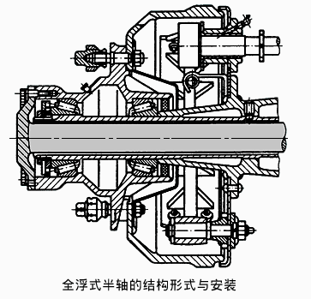
全浮式半轴支承
Full floating axle support
半轴外端与轮毂通过螺栓连接，轮毂通过圆锥滚子轴承或球轴承支承在桥壳的半轴套管上。Outer end of the axle shaft and hub are connected by bolts，the hub is supported on the axle tube of axle housing by conical roller bearing or ball bearing.

Slide 55
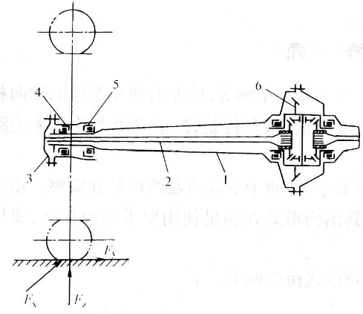
全浮式半轴支承
Full floating axle support
特点：半轴内外端只受转矩不受弯矩。Characteristics：the inner and outer ends of axle shaft are subjected to only torque but no bending moment
F_{y}
F_{x}
F_{z}
所谓“浮”指卸除半轴的弯曲载荷而言。The so-called“floating”means the bending load of axle shaft is removed

Slide 56
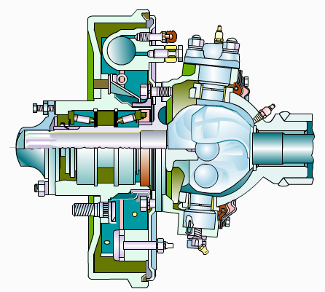
全浮式半轴支承
Full floating axle support

Slide 57
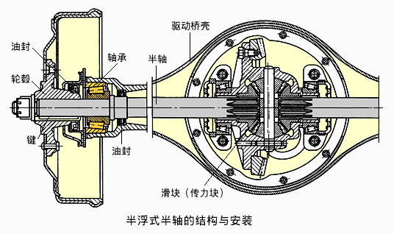
半浮式半轴支承
Semi-floating axle support
半轴外端通过轴承支承在桥壳的凸缘上。The outer end of axle shaft is supported on the axle housing flange by bearing.

Slide 58
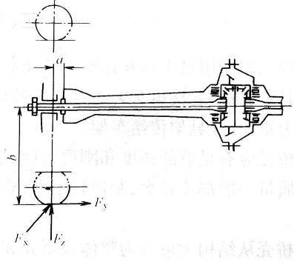
半浮式半轴支承
Semi-floating axle support
特点：作用在车轮的力都直接传给半轴，再通过轴承传给驱动桥壳体，半轴既受转矩，又受弯矩。Features：the force acting on the wheel is directly transmitted to axle shaft，and then passed to the drive axle housing through the bearing . Axle shaft is subjected to both torque and bending moment.
F_{y}
F_{x}
F_{z}

Slide 59
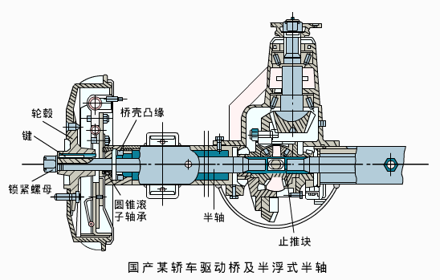
半浮式半轴支承
Semi-floating axle support
为使半轴和车轮不致被向外的侧向力拉出，轴承必须能承受向外的轴向力；In order to ensure the axle and the wheel will not be pulled out by lateral force ，bearings must be able to bear the outward axial force ；
为使半轴和车轮不致因向内的侧向力而向内窜动，在差速器行星齿轮轴的中部浮套着止推块。In order to ensure the axle and the wheel will not move inward by lateral force ，floating in the middle of the planetary-gear pin of the differential is a thrust block.

Slide 60
两种半轴支承方式比较Comparison of two axle support
全浮式半轴 Full floating axle support
半轴和桥壳没有直接的联系； no direct link between axle and axle housing
全浮式半轴内外均不承受外来弯矩； The inner and outer ends of full - floating axle are not subject to external moment
半轴可以从半轴套管中抽出，拆卸容易； can be easily withdrawn from the axle tube
结构比半浮式复杂。Structure is more complex than the semi-floating axle
半浮式半轴 Semi-floating axle support
半轴一端支承在桥壳上； One end of axle shaft is supported on axle housing
半轴外端除承受车轮传来的弯矩外，还承受弯矩；但内部不承担弯矩；The outer end is subjected to not only the torque from wheels but also bending moment；but inner end is subjected to no bending moment；
结构比全浮式简单；Structure is simpler than full floating axle；
多用于轿车。It is mostly used in cars

Slide 61
桥壳的作用 Functions of axle housing
支承并保护主减速器、差速器和半轴，固定驱动轮，使轮距保持不变； To support and protect the final drive , differential and axle shafts，fix driving wheels，make wheel tread unchanged
支承车架及车架上各总成的重量； To support frame and the assembly weight on the frame
承受汽车的行驶时，车轮传来的力和力矩，并通过悬架系统传给车架。To withstand force and moment from wheels when vehicle is running，and pass them to the frame by suspension system.
对桥壳的要求
Requirements for axle housing
桥壳的分类
Classification of axle housing
刚度和强度大；High stiffness and strength
质量轻； Light weight
便于主减速器的拆卸和安装； Easy removal and installation of final drive
便于制造。Ease manufacturing
按结构分为
By structure
整体式 Banjo axle housing
分段式Sectional type axle housing

Slide 62
整体式桥壳 Banjo axle housing
特点：具有较大的强度和刚度，且便于主减速器的装配、调整和维修。 Traits： high stiffness and strength ， Easy removal and installation of final drive 、 adjustment and maintenance
按制造方法
By manufacturing method
整体铸造式 Integral casting type
中段铸造式 Middle of casting type
钢板冲压焊接式 Welded steel stamping type
钢管扩张成形式 Steel pipe expansion type

Slide 63
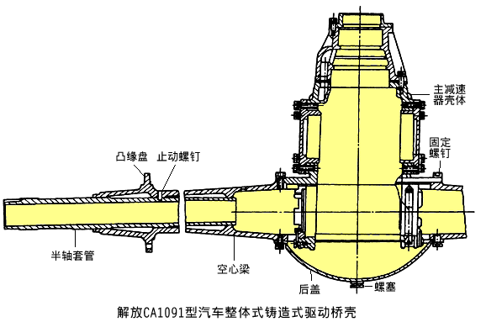
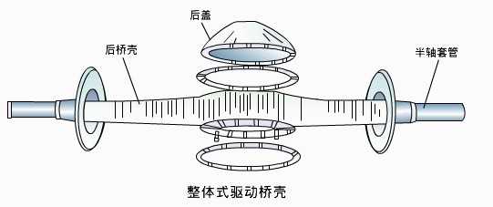
整体式桥壳 Banjo axle housing
缺点：质量大、铸造质量不易保证； high weight, the casting quality is not easy to guarantee
适用于中、重型汽车，更多用于重型汽车。It is suitable for medium and heavy-duty vehicles , and more for heavy-duty vehicles。

Slide 64
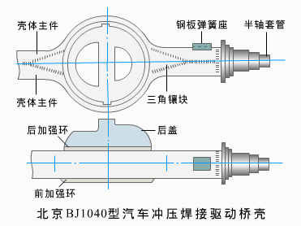
钢板冲压焊接式桥壳
Welded steel stamping axle housing
特点：质量小，制造工艺简单，材料利用率高，抗冲击性好。Traits：light weight，simple manufacturing process，high utilization of materials，good impact resistance

Slide 65
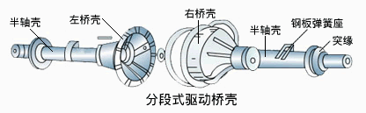
分段式桥壳 Sectional type axle housing
特点：便于制造，工艺简单，但装车后不便于驱动桥的维修。Traits：easy manufacturing，simple process，inconvenient repair

Slide 66
本章学习重点
Learning Objectives of this chapter
驱动桥的功用；Functions of drive axle；
几种不同形式主减速器的结构特点； Characteristics of several types of final drive
差速器的差速原理； Principle of the differential
差速器的转矩分配特性； Characteristics of torque distribution of differential
全浮式半轴和半浮式半轴在结构上各有什么特点？Structural traits of full floating axle and semi-floating axle？

Slide 67
作业 Homeworks
双速主减速器有何特点？试说明行星齿轮式双速主减速器的工作原理。Characteristics of two-speed final drive？Try to explain the principle of two speed planetary final drive.
驱动桥中为什么要设置差速器？对称式锥齿轮差速器中为什么左右两侧半轴齿轮的转速之和等于差速器壳转速的两倍? Why is differential installed in final drive？Why is the sum of speed of left and right side gears twice of that of differential case in symmetric bevel gear differential?
全浮式半轴和半浮式半轴在结构上各有什么特点？半浮式轴承通常只有一个轴承支承，那么侧向力是如何来承受和平衡的？Characteristics of floating axle and semi-floating axle ？Semi-floating bearing is usually supported by only one bearing ，then how is lateral force beared and balanced ？

